Slide 1
Zero-Shot Text-to-Image Generation
Presenter: Fang Xianghong
20 Apr, 2021

Slide 2
Outline
Problem Definition
Review of VQ-VAE
DALLE Model
Datasets and Experiment setting
Learn Image Tokens From VQ-VAE
Learn Joint Prior Through GPT-3
Generation Samples
Conclusion

Slide 3
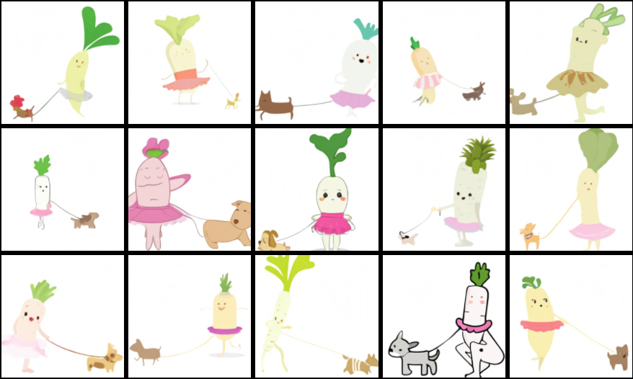
Problem Definition
Zero-Shot Learning aims to recognize objects whose instances may not have been seen during training. Similarly, Zero Shot Image Generation aims to generate instances in images that people may not have been seen during training.
Text Prompt:
An illustration of a baby daikon radish in a tutu walking a dog!

Slide 4
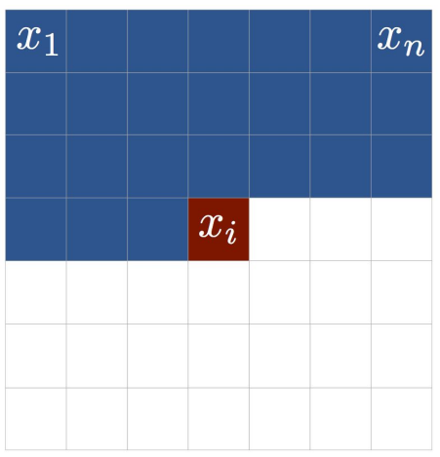
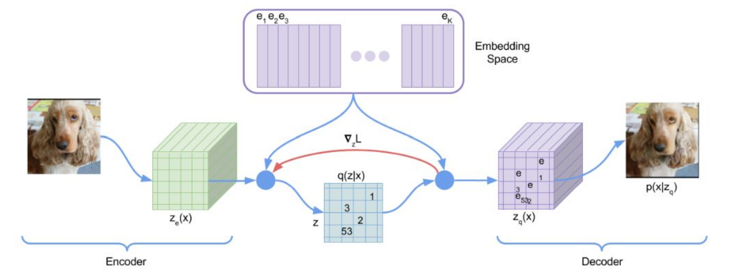
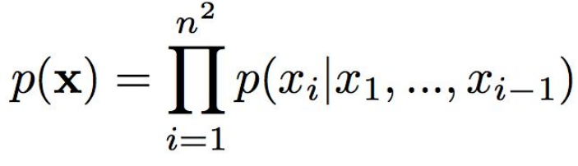
Review of VQ-VAE
propose neural discrete representation, transform image to image tokens, an auto-regressive model (like LSTM, PixelCNN and Transformer) can be learned with tokens.
update embedding space through online cluster assignment procedure
straight-through estimator for gradient pass. (Straight-through estimator, gumbel-softmax, policy gradient in RL)

Slide 5
Review of VQ-VAE
VQ-VAE (straight-through estimator )
Forward pass
Backward pass
Encoder
Decoder
copying the gradient of to
the operation: copying the gradient of to , is straight-through estimator.
when the dimension of z is higher with fixed number of codebooks, the distance between the latent variables and its nearest codebook would be higher, thus causing bad result for reconstruction.

Slide 6
DALLE Model: Datasets and Experiment setting
Dataset Scales:
1.2 billion parameters dalle model(GPT-3): Conceptual Captions dataset contains 3.3 million text-images pairs.
12 billion parameters dalle model(GPT-3): collecting 250 million text-images pairs from the internet.
Experiment Setting:
Image size 256*256, to 32 * 32 via Encoder.
Use 8192 codebooks.

Slide 7
DALLE Model: Learn Image Tokens From VQ-VAE
form of
probability
approximating
to one-hot
images
Uniform categorical distribution
Gumbel Softmax
KL Term
Encoder
Embedding Space
Decoder
Slight difference to initial VQ-VAE
due to the use of gumbel softmax trick, Embedding space (or codebook) can be updated through the gradient backpropagation directly instead of online cluster assignment procedure.
as gumbel softmax could enforce gradient backpropagation from to , straight-through estimator was relaxed.
obtain image tokens from , the tokens = argmax .

Slide 8
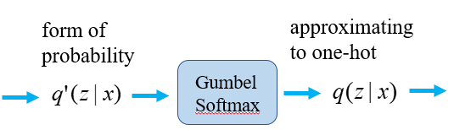
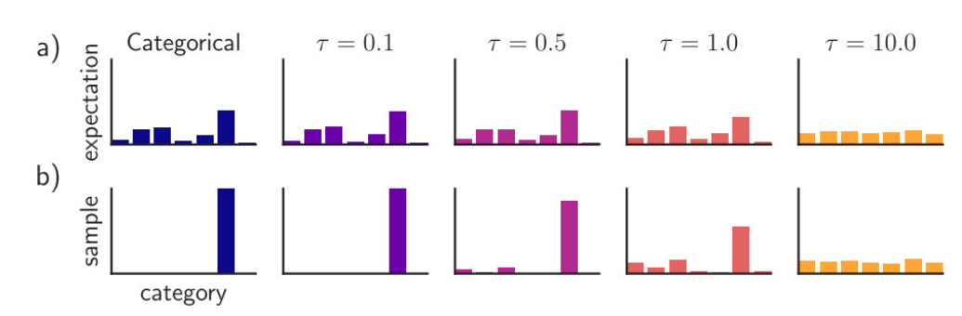
DALLE Model: Learn Image Tokens From VQ-VAE
VQ-VAE (gumbel softmax)
Remark: Gumbel softmax is continuous form of function,

Slide 9
DALLE Model: Learn Joint Prior Through GPT-3
256 BPE-encode Token
Vocabulary size 16384
1024 Tokens
Vocabulary size 8192
Joint Prior
Text Tokens
Image Tokens
Represent joint distribution of Text and Image via the concatenation of the text tokens and image tokens.
Model the joint prior via an auto regressive model, e.g. GPT-3

Slide 10
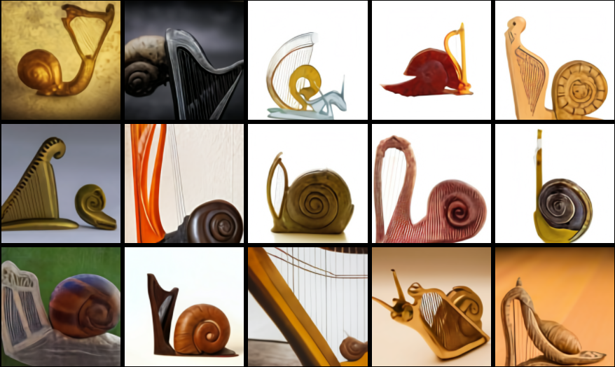
DALLE Model: Generation Samples
Combining unrelated concepts
Text Prompt:
a snail made of harp. a snail with the texture of a harp.

Slide 11
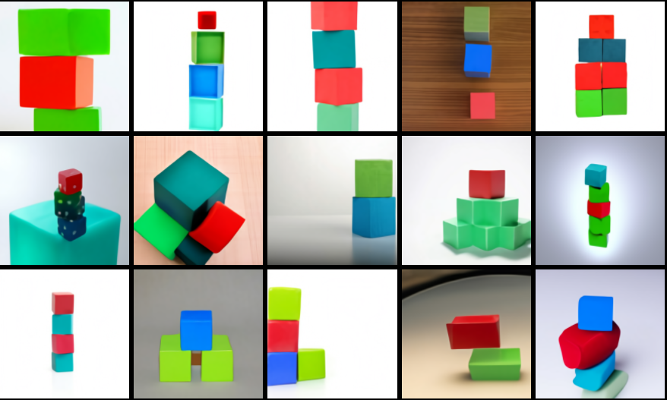
DALLE Model: Generation Samples
Drawing multiple objects
the number of objects and
its order is not accurate.
More generation examples in page: https://openai.com/blog/dall-e/
Text Prompt:
a stack of 3 cubes. a red cube is on the top, sitting on a green cube. the green cube is in the middle, sitting on a blue cube. the blue cube is on the bottom.

Slide 12
Conclusion
Obtain image tokens from VQ-VAE model, the length of image sequence would be shorter, for example, the RGB sequence length is 256 * 256 * 3, while the length of image tokens from VQ-VAE model is 32 * 32. Shorter sequence dependency would be better modelled by GPT-3 model.
Represent the joint distribution of text and image through the concatenation of the text tokens and image tokens. It also can be applied to other multi-modal task, such as text-audio pairs.
Dalle model also can be applied to image captions task.
Joint Prior
Image Tokens
Text Tokens

Slide 13
